Slide 1

Measuring What Matters
Turning Recognition Data into Insight Leaders Can Act On
Featuring Nik Bilyk, Employee Experience & Insights Manager,
A.W. Companies
Customer Masterclass

Slide 2


Welcome and Session Goals
Today we will:
1
Define what recognition success means
2
Measure adoption, engagement, reach, and quality
3
Find gaps hidden by company averages
4
Connect recognition to employee sentiment and business goals
5
Build a review rhythm leaders can use
Housekeeping: recording, Q&A panel, and follow-up resources available after the session.
Presenter: Brittany
2

Slide 3


Recognition Volume Is an Activity Metric
A successful program should also:
Strengthen Culture
Reinforce Values & Strategic Behaviors
Improve the Employee Experience
Support Business Goals
Thousands of recognitions can still come from, or reach, only a small percentage of employees.
Presenter: Sam
4

Slide 4
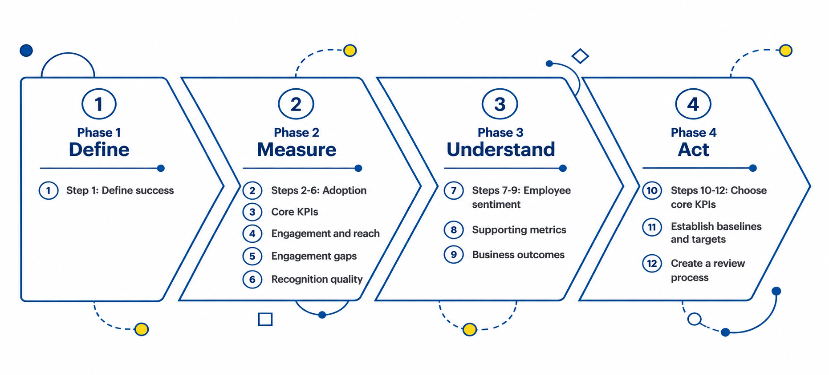
The 12-Step Measurement Framework
Presenter: Sam
5

Slide 5

Step 1: Program Objectives
Possible objectives:
Increase engagement or morale
Strengthen culture and values
Encourage collaboration
Increase recognition consistency
Reach frontline or deskless employees
Reinforce strategic behaviors
Improve retention
Improve manager effectiveness
What are the three most important outcomes for your program?
Presenter: Sam
6

Slide 6
Objectives and KPIs
Measure progress toward the objective rather than every number available.
Objective | Starting KPI
Increase employees giving recognition | Sender RES
Increase employees receiving recognition | Recipient RES
Increase manager participation | Manager Sender RES
Increase program adoption | Active User Rate or Monthly Active Users
Presenter: Sam
7

Slide 7

Step 2: Program Adoption
Active User Rate
Monthly Active Users
The percentage of eligible employees who have activated or accessed the program.
The percentage of eligible employees who logged in during the month.
Employees cannot participate in a program they have not adopted, but access alone does not show meaningful recognition activity.
Presenter: Sam
8

Slide 8
Monthly Active Users and Sender RES
Monthly Active Users
Sender RES
"Are employees accessing the platform?"
Activities may include viewing, reacting, nominating, surveying, completing a Challenge, or redeeming.
"Are employees actively giving recognition?"
Counts active employees who sent at least one recognition during the period.
These metrics answer different questions.
Presenter: Sam
9

Slide 9


Feature Adoption
Track the program components you intentionally offer:
Peer & Manager Recognition
Badges and milestones
Nominations & Challenges
Rewards programs
Surveys & Integrations
Connected workflows
Low use should prompt questions about awareness, education, workflow fit, or strategy.
Presenter: Sam
10

Slide 10
Step 3: Core Recognition KPIs
Sender RES
Recipient RES
Manager Sender RES
Program engagement: percentage of active employees who sent recognition
Program reach: percentage of active employees who received recognition
Manager engagement: percentage of managers who sent recognition
Presenter: Sam
11

Slide 11
Engagement Gaps and Meaning
Read engagement and reach together
Segment results by employee group
Evaluate manager participation
Measure recognition quality
Pair recognition with sentiment and business outcomes
Presenter: Alexia
12

Slide 12
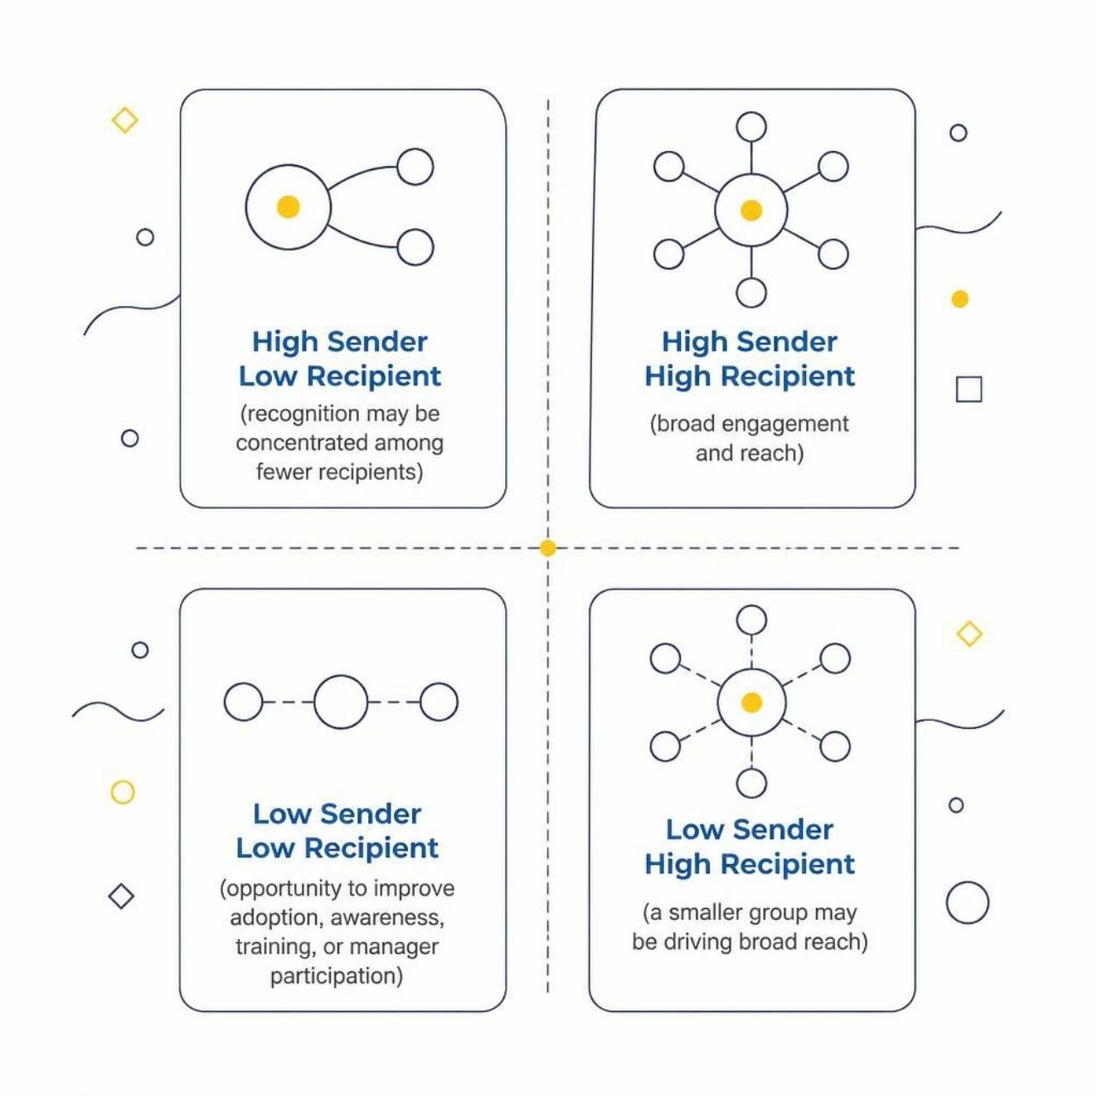
Step 4: Engagement and Reach Together
These combinations provide diagnostic signals rather than automatic grades.
High Sender + High Recipient
High Sender + Low Recipient
Broad engagement and reach
Recognition may be concentrated among fewer recipients
Low Sender + High Recipient
Low Sender + Low Recipient
A smaller group may be driving broad reach
Opportunity to improve adoption, awareness, training, or manager participation
Presenter: Alexia
13

Slide 13
Step 5: Engagement Gaps
Segment Sender RES, Recipient RES, and Manager Sender RES by:
Department or job function
Location
Employee population
Frontline vs. corporate
Direct-report manager
Tenure
Remote vs. in-office
Key question: Who is having a different recognition experience?
Presenter: Alexia
14

Slide 14


The Manager Lens
Compare managers side by side:
Who consistently recognizes employees?
Which teams rely mainly on peer recognition?
Whose participation has declined?
Which strong habits could other leaders adopt?
Low manager participation alongside reasonable team reach may mean peers are covering a leadership gap.
Presenter: Alexia
15

Slide 15

Step 6: Recognition Quality
Value Alignment
Message Quality
Variety
Are messages connected to values, competencies, or strategic behaviors?
Do they explain what happened, why it mattered, and who benefited?
Does recognition reflect different behaviors, teams, locations, and milestones?
Presenter: Alexia
16

Slide 16







Step 7: Recognition and Sentiment
Compare the same employee groups across:
Manager Sender RES
Recipient RES
Sender RES
"I feel appreciated for
my contributions"
Engagement Score
eNPS
The comparison identifies gaps worth investigating. It does not prove recognition caused the sentiment score.
Presenter: Alexia
18

Slide 17
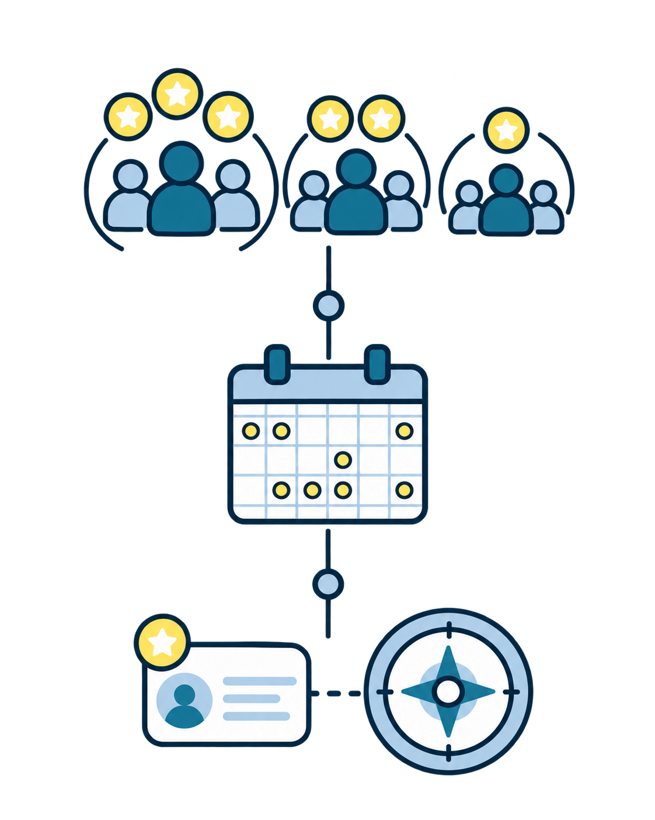
Step 8: Supporting Metrics
Distribution
Employees receiving zero, one, or multiple recognitions
Frequency
Recognitions per employee or sender and trends over time
Alignment
Most and least recognized values, behaviors, and recognition types
Core KPIs show what is happening. Supporting metrics help explain why.
Presenter: Alexia
19

Slide 18


Step 9: Business Outcomes
Compare recognition signals with outcomes leaders already track:
Voluntary Turnover & Retention
Goal Achievement & Productivity
Quality & Sales Performance
Customer Satisfaction or Loyalty
Attendance & Safety
Employee Referrals & Team Performance
A relationship provides a signal to investigate. It does not prove causation.
Presenter: Alexia
20

Slide 19

GUEST SPEAKER
Nik Bilyk
Employee Experience & Insights Manager
A.W. Companies
A.W. Companies is a talent and outsourcing partner specializing in staffing, recruiting, and contact center operations.
Nik will share how A.W. Companies connects recognition to business priorities, trains leaders on meaningful recognition, and builds Recognize into the employee experience.
Presenter: Alexia
21
Notes:
Presenter: Alexia
Target time: 1:30
We have looked at the data leaders can use to understand participation, quality, and business impact. Now we will hear how one organization puts those ideas into practice. Nik Bilyk is the Employee Experience and Insights Manager at A.W. Companies. He works closely with frontline leaders to connect recognition to retention, employee experience, company values, and business goals. Nik will share how A.W. Companies introduces Recognize, trains its leaders, and plans to use program data more consistently.
Transition: Nik, welcome. I’ll turn it over to you.

Slide 20

Presenter: Nik
22
Notes:
Presenter: Nik
Target time: 1:00
Thank you, Alexia, and thank you to everyone joining today. I’m Nik Bilyk, Employee Experience and Insights Manager at A.W. Companies. I’m going to share how we use Recognize in a contact center and recruiting environment, where employee experience directly affects both performance and retention. I’ll focus on practical choices: how we introduce the platform, how we train leaders, why message quality matters more than simply distributing every available point, and how we want to give leaders better information about their teams.
Transition: I’ll start with a little context about A.W. Companies and my role.

Slide 21
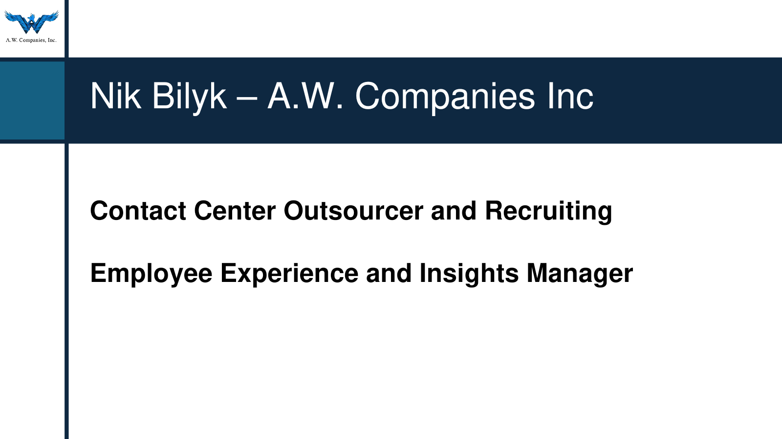
Presenter: Nik
23
Notes:
Presenter: Nik
Target time: 1:45
A.W. Companies supports contact center outsourcing and recruiting. In my role, I work at the intersection of employee experience, engagement, and business operations. That matters because recognition cannot sit apart from the way the organization operates. Our leaders need to understand how recognition supports the employee experience and the results our clients expect. We started using Recognize in 2021, and over time it has become a meaningful part of how employees experience our workplace.
Transition: Our mission gives us a useful starting point for deciding what recognition should reinforce.

Slide 22
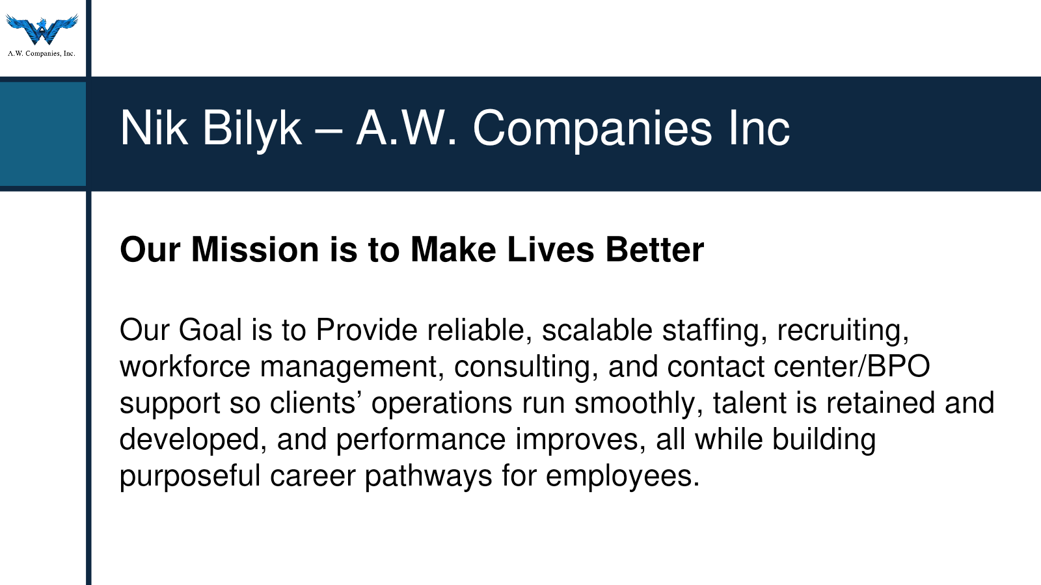
Presenter: Nik
24
Notes:
Presenter: Nik
Target time: 1:45
Our mission is to make lives better. We aim to provide reliable staffing, recruiting, workforce management, consulting, and contact center support while helping people build purposeful career paths. Recognition supports that mission when it reinforces the behaviors that help employees grow and help our clients succeed. This connection is important. If recognition only feels like an occasional reward, it misses the opportunity to teach people what the organization values and encourage the behaviors that move the business forward.
Transition: That connection is one of the main reasons Recognize matters in our environment.

Slide 23
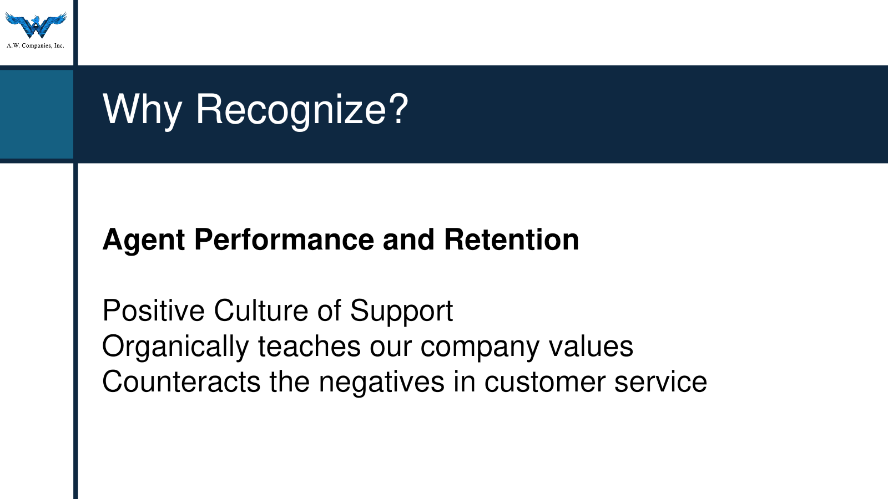
Presenter: Nik
25
Notes:
Presenter: Nik
Target time: 2:15
Retention is a critical business metric for us because turnover carries real costs for A.W. Companies and for our clients. Contact center employees also receive a fair amount of corrective or negative feedback as part of the job. Recognize gives leaders a structured way to balance that feedback with specific encouragement and appreciation. We also use recognition to reinforce our company values and support our goal of being staffing experts. Employees notice the difference. Many see the program as a valued workplace perk and something that distinguishes A.W. Companies from other places they have worked.
Transition: We begin building that experience as soon as a new employee joins.

Slide 24
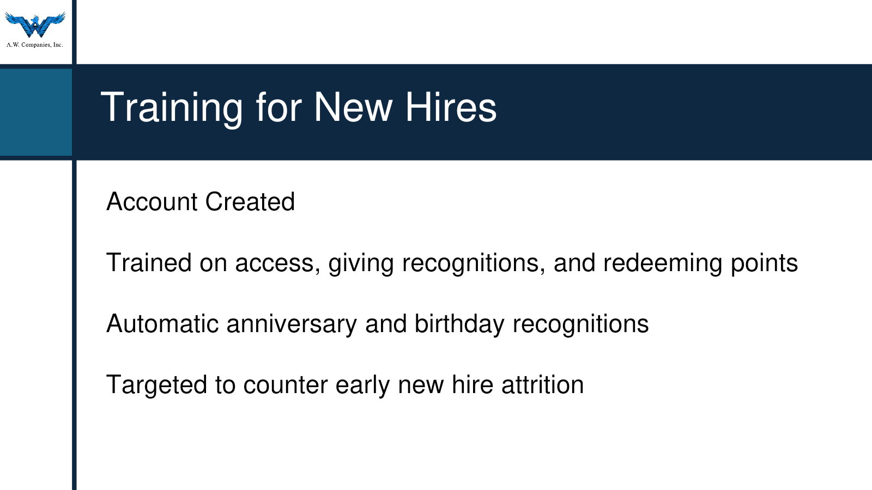
Presenter: Nik
26
Notes:
Presenter: Nik
Target time: 2:00
For new hires, we create the account and teach the practical basics: how to access Recognize, give recognition, and redeem points. We also explain the automatic birthday and anniversary recognitions they may receive. That early introduction is intentional because much of our attrition occurs within the first 30 to 90 days. Trainers make sure employees can find and use the platform, which helps recognition become part of the normal employee experience rather than a tool people discover months later.
Transition: Leaders receive a deeper level of training because their choices shape the quality of the program.

Slide 25
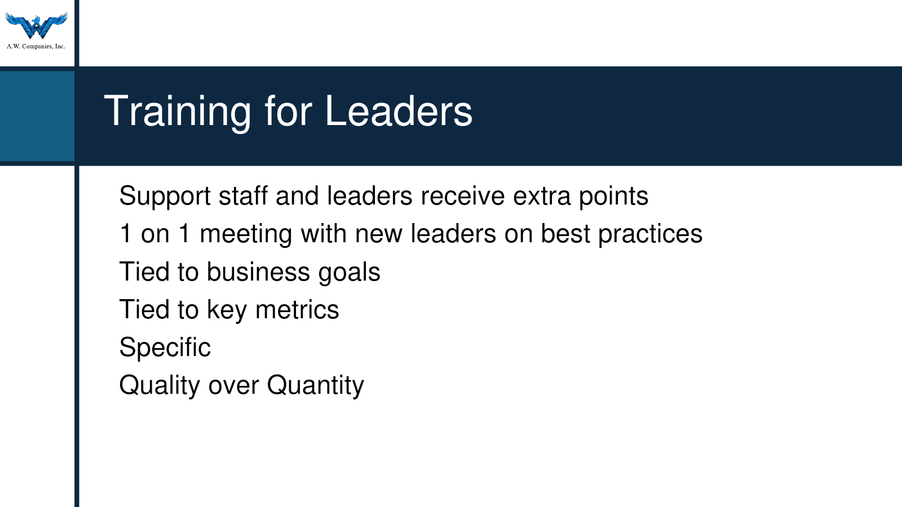
Presenter: Nik
27
Notes:
Presenter: Nik
Target time: 2:30
Anyone who supports our agents receives additional points to give. I meet one on one with new leaders to connect recognition to business goals and work through both weak and strong examples. We talk about encouragement, rewarding growth, reinforcing a particular metric, and recognizing progress after coaching. Specificity is the biggest point of emphasis. We do not measure success by whether leaders spend every point. If the message is generic or sent in bulk without meaning, it does little to reinforce behavior or build trust. Quality matters more than quantity.
Transition: Here is an example of the kind of recognition that feels personal and memorable.

Slide 26
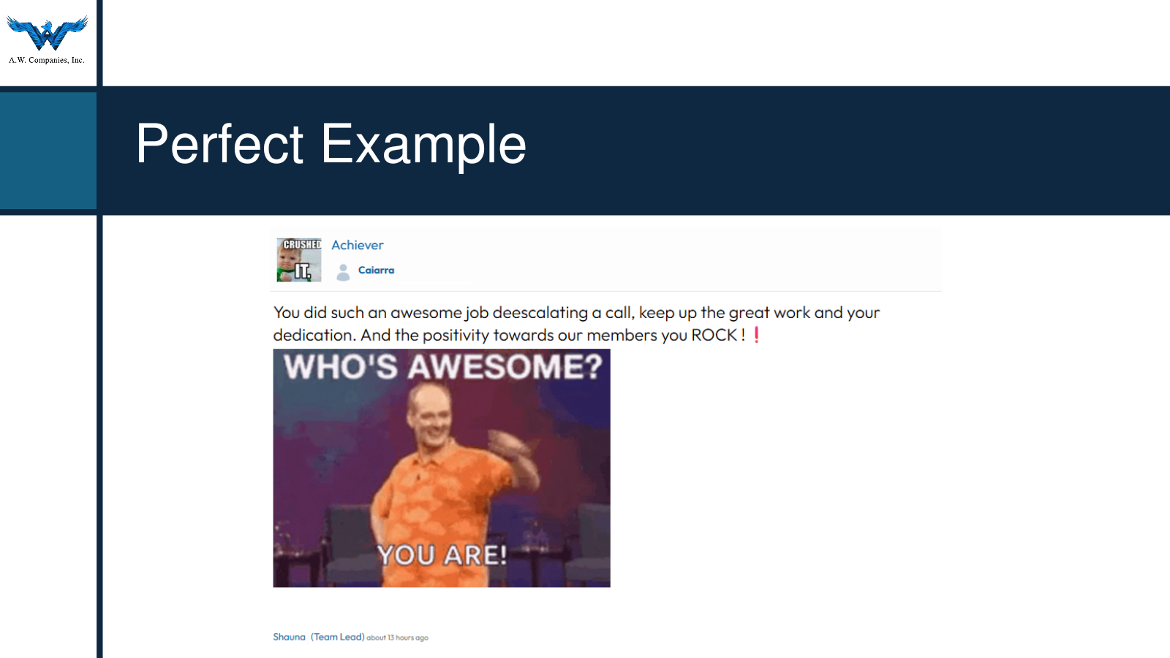
Presenter: Nik
28
Notes:
Presenter: Nik
Target time: 1:45
This example works because it sounds like a real person noticing another person’s contribution. The message names what happened and why it mattered. Even when the tone is light or humorous, the recipient can tell what behavior the sender appreciated. That makes recognition more credible and gives other employees a concrete example of what good work looks like. When we coach leaders, we encourage them to move beyond a generic thank you and include the action, the impact, or the growth they observed.
Transition: Those expectations fit into a broader program structure we have built since 2021.

Slide 27
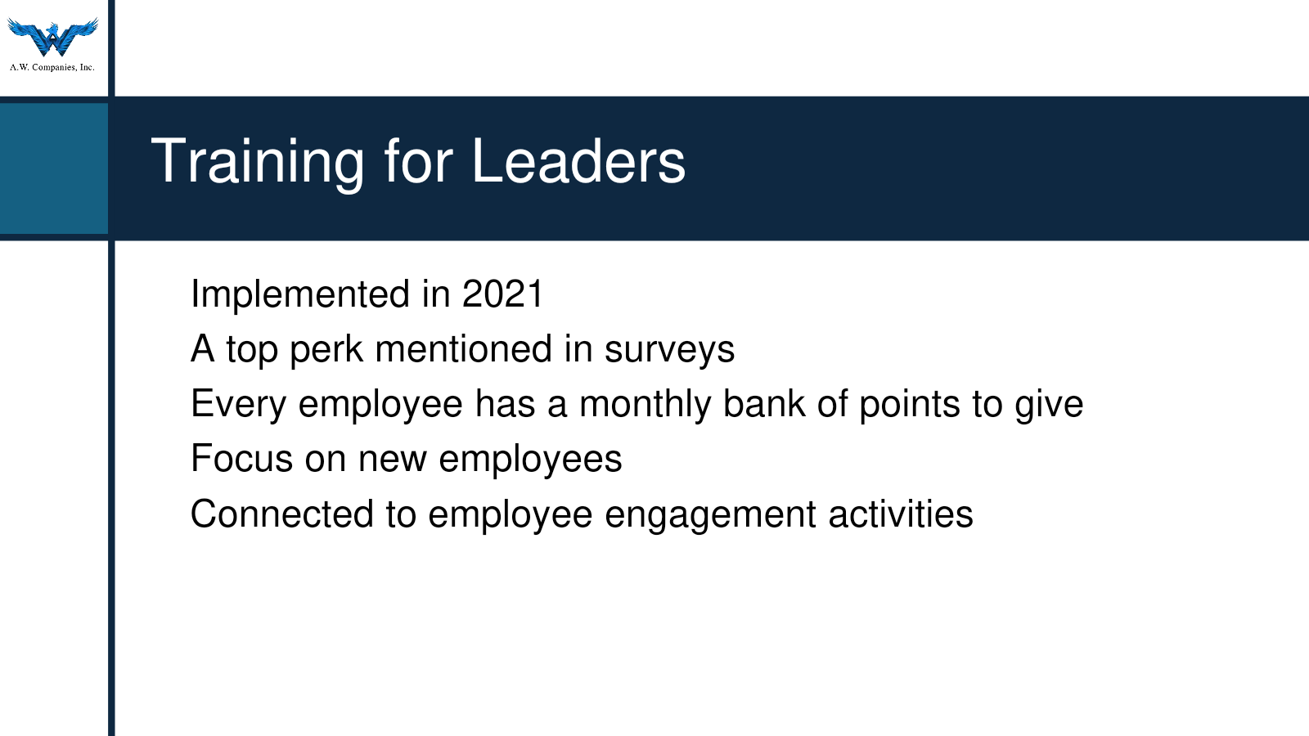
Presenter: Nik
29
Notes:
Presenter: Nik
Target time: 2:00
Every employee receives a monthly bank of points to give, including entry-level staff. That choice makes recognition available across the organization instead of limiting it to managers. We also created badges connected directly to company values, which helps employees learn and use the language of those values. Recognition supports other engagement activities as well. The goal is a program that employees can participate in naturally, while leaders model the quality and business connection we want to see.
Transition: Our next opportunity is to turn program activity into clearer insight for leaders.

Slide 28
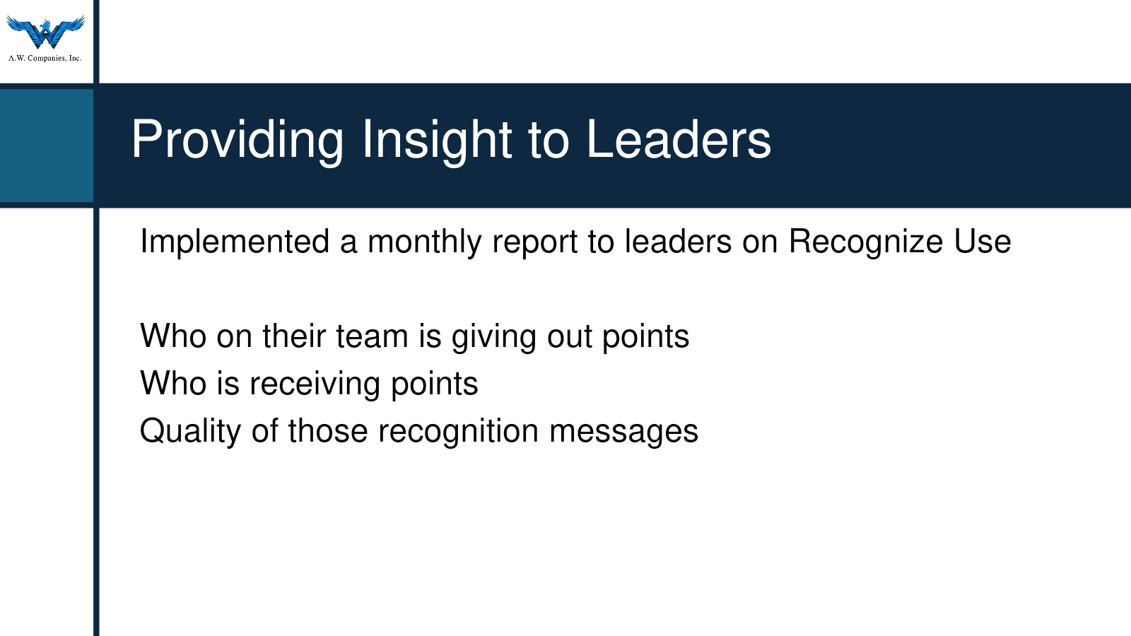
Presenter: Nik
30
Notes:
Presenter: Nik
Target time: 2:30
We plan to provide leaders with a monthly report on Recognize usage. The report can show which team members are giving points, who is receiving them, and whether the messages are specific and meaningful. This is still an emerging practice for us, so I want to be clear that we are building the process rather than presenting a finished model. The value will come from helping leaders ask better questions. Is recognition concentrated among a few people? Is someone receiving little or no recognition? Are messages tied to growth, values, and performance? Those questions can turn platform data into useful coaching conversations.
Transition: I’ll close with a few wins that show how we have already used the program in practical ways.

Slide 29
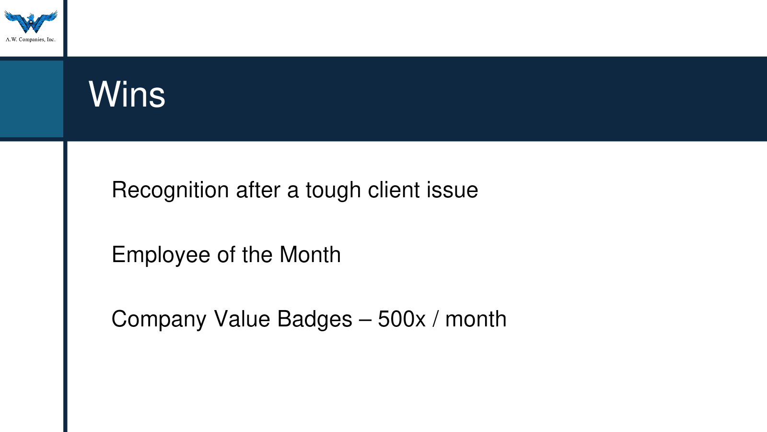
Presenter: Nik
31
Notes:
Presenter: Nik
Target time: 2:30
One important win came after a difficult client issue created a very challenging month for employees. We worked with the client to provide a small bonus and distributed it through Recognize as a direct thank you to the team. We also use the platform for Employee of the Month and company value badges, with roughly 500 value badges awarded each month. Beyond formal programs, we keep participation fresh with activities such as a pumpkin carving contest, a March Madness bracket, and World Chocolate Day. These examples work because they connect recognition to what employees are experiencing in the moment.
Transition to Brittany: That is how A.W. Companies connects recognition, leader habits, and employee experience. Brittany, I’ll hand it back to you to translate these ideas into a practical scorecard and action plan.

Slide 30
Step 10: Core KPI Scorecard
KPI | What It Measures
Active User Rate | Program adoption
Monthly Active Users | Ongoing platform usage
Sender RES | Program engagement
Recipient RES | Program reach
Manager Sender RES | Manager engagement
eNPS or engagement | Employee experience
Retention or another outcome | Organizational impact
Presenter: Brittany
30
Notes:
Presenter: Brittany
Target time: 2:00
Thank you, Nik. Your examples show why a scorecard needs to lead to a useful conversation with leaders. Let’s bring the framework and the real-world practices together in one concise view.

Slide 31

Step 11: Baseline and Targets
Start with current performance. Set targets based on: program objectives, current results, program maturity, and desired outcomes.
KPI | Current | Target
Active User Rate | ___ | ___
Sender RES | ___ | ___
Recipient RES | ___ | ___
Manager Sender RES | ___ | ___
Choose targets that represent meaningful improvement from your starting point.
Presenter: Brittany
31

Slide 32
Step 12: Review Process
Monthly
Quarterly
Annually
Adoption, activity, core RES metrics, frequency, and distribution
Trends, group comparisons, manager participation, feature adoption, sentiment, and alignment
Retention, engagement, business outcomes, and progress toward objectives
Assign an owner who determines the response when a metric changes meaningfully.
Presenter: Brittany
32

Slide 33
A 30-Day Action Plan
01
02
Choose two or three core KPIs
Establish the current baseline
03
04
Run one segmented report
Identify one gap or strong practice
05
06
Share the finding with the relevant leader
Agree on one action, owner, and review date
Insight becomes valuable when it changes a decision or behavior.
Presenter: Brittany
33

Slide 34
Questions?
Resources
Measuring the Success of Your Employee Recognition Program
A.W. Companies
Webinar Recording & Slides
awcompaniesinc.com
Recording and slides to follow after the session.
faq.recognizeapp.com — Measuring the Success of Your Employee Recognition Program
Thank you to Sam, Alexia, Nik Bilyk, and A.W. Companies.
Presenter: Brittany
34

