Slide 1
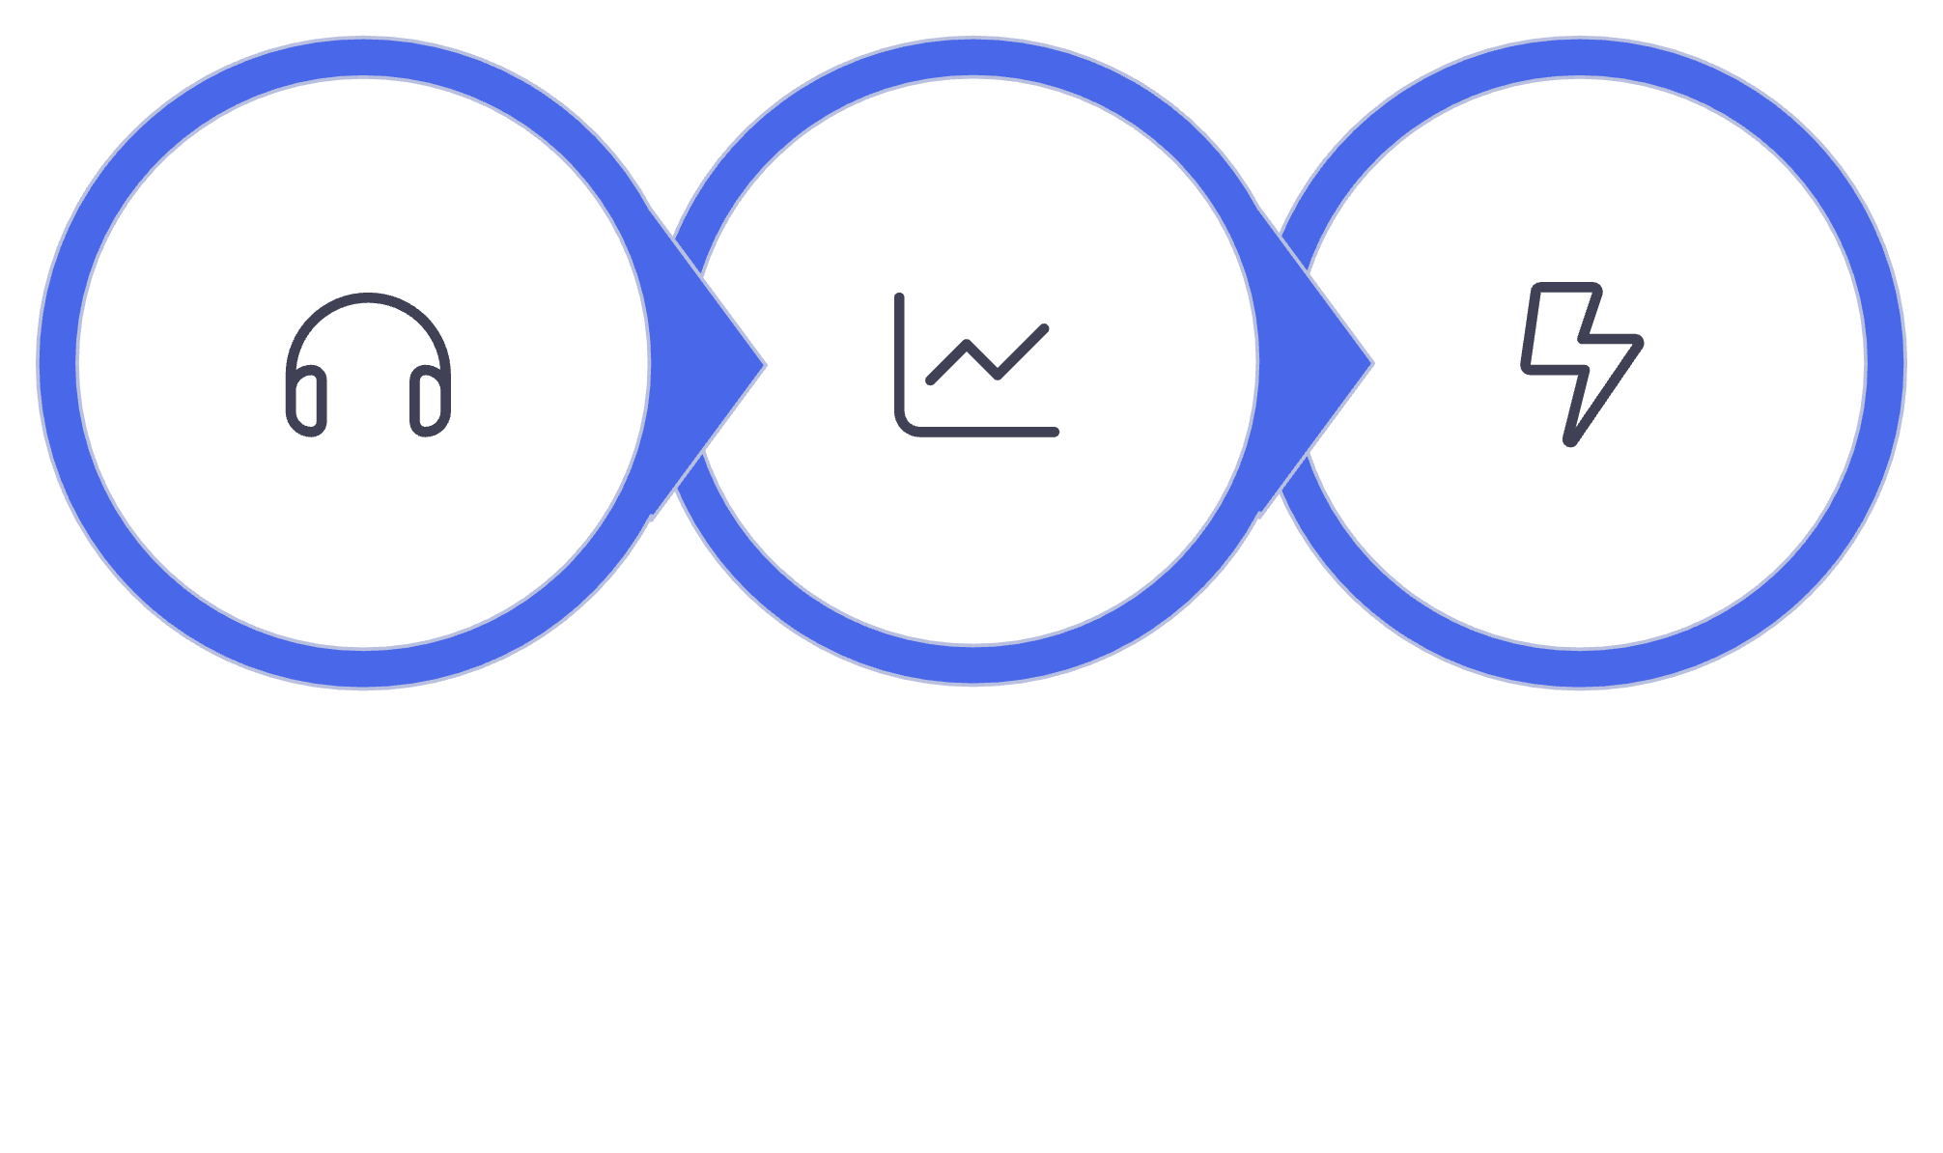
Recognize Customer Masterclass
The Survey Playbook
How to Listen, Spot Trends, and Act Without Burning Out Your Team
Listen
Spot Trends
Act
Notes:
Speaker: Brittany
Welcome, everyone, to our Recognize Customer Masterclass. Today we’re going to build a practical survey strategy that helps you gather useful feedback without exhausting employees, managers, or People Ops.
We’ll focus on three connected skills: listening intentionally, identifying meaningful patterns, and translating feedback into a visible response.
The goal is not to survey more frequently. It is to make every survey earn its place by connecting it to a real decision and a credible response.

Slide 2
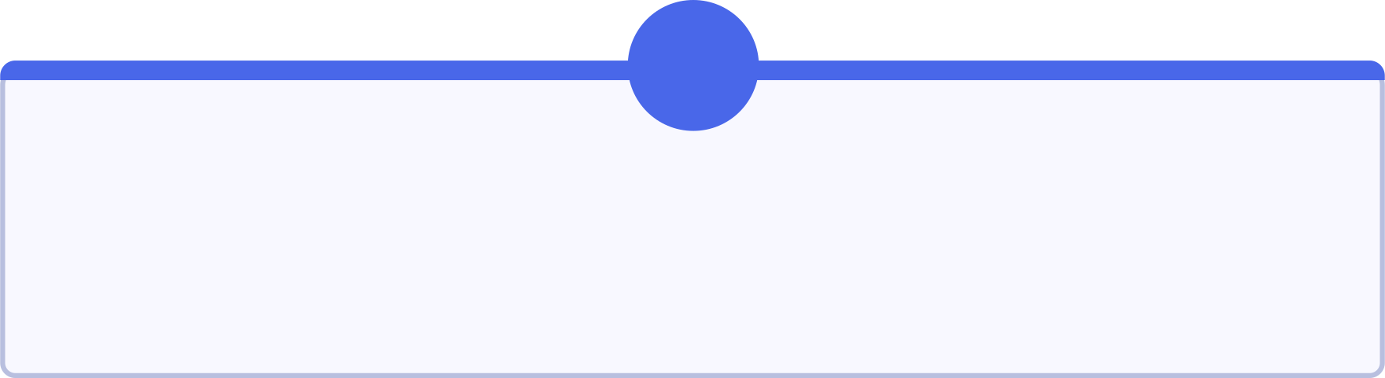
TODAY'S PLAYBOOK
Six Skills for Smarter Listening
1
2
Choose the Right Survey
Design Focused Questions
Match the tool to the decision
Less clutter, clearer signal
3
4
Build a Listening Rhythm
Find Hidden Risks
Sustainable, predictable cadence
Look beneath the averages
5
6
Turn Feedback Into Action
Build a Custom Pulse
Make the response visible
Targeted, timely, purposeful
Notes:
Speaker: Brittany
This is designed as an interactive working session. We’ll review the three primary survey types, improve an overly broad survey, interpret a sample heatmap, and explore the Recognize survey feature.
As we proceed, think about one current organizational decision that would benefit from employee input. It might be a policy change, manager initiative, onboarding experience, workplace transition, or communication challenge.
You’ll use that example during our action-planning exercise near the end.

Slide 3
AUDIENCE ACTIVITY
What Is Your Biggest Survey Challenge?
Take a moment to reflect — then share your answer with the group.
A
B
C
Low participation
Too many surveys
Difficulty interpreting results
D
E
Limited manager follow-through
Employees don't see action
Notes:
Speaker: Brittany
Let’s begin by understanding what brought everyone here.
Which challenge feels most familiar?
Low participation
Too many surveys
Difficulty interpreting results
Limited manager follow-through
Employees do not see action
Give participants time to respond.
After the results appear, acknowledge the leading answer:
“It looks like our biggest shared challenge today is ____. Keep that result in mind because we’ll address it directly during the session.”
If responses are evenly distributed, note that survey strategy often breaks down at multiple points—not only during survey creation.

Slide 4

Surveying Is Not the Same as Listening
20%
Global Engagement
Of employees worldwide report feeling engaged at work
Collecting feedback is only half the work. True listening means employees can see how their input shaped a decision, action, or explanation.
The goal is not more data — it is better decisions and evidence that employee voices mattered.
Notes:
Speaker: Brittany
Collecting feedback is a transaction. Listening includes showing employees how their input shaped a decision, action, or explanation.
That distinction matters because global employee engagement fell to 20% in 2025, its lowest level since 2020. Gallup estimates that low engagement cost the global economy approximately $10 trillion in lost productivity. Gallup’s 2026 State of the Global Workplace
An organization can gather substantial data while still making employees feel unheard.
Before launching a survey, identify what the information will help you decide and how employees will learn what happened afterward.

Slide 5


Survey Fatigue — or Inaction Fatigue?
Most employees don't tire of being asked. They tire of not being heard. Five common causes of disengagement from surveys:
Unclear Purpose
Too Many Questions
Wrong Audience
Employees don't know why they're being asked
Long surveys drain goodwill and lower completion
Irrelevant surveys signal poor targeting
Missing Follow-Through
Too Many Promises
Feedback goes in — and nothing comes out
Overpromising and underdelivering erodes trust
Before launch, every survey needs a decision, an owner, and a response plan.
Notes:
Speaker: Brittany
Survey fatigue is not always caused by frequency. It often comes from unclear purpose, irrelevant questions, poor targeting, or missing follow-through.
Compare these requests:
“Please complete our annual 35-question employee survey.”
Versus:
“We’re deciding how to revise the new scheduling policy. These four questions will guide that decision, and we’ll share our initial response next Friday.”
The second request tells employees why their input matters and what will happen afterward.
Before launching, every survey should have three things:
A decision it will inform
An owner responsible for the response
A communication plan
If one is missing, the survey probably is not ready.

Slide 6



The 3-Tier Listening Framework
eNPS
Engagement Survey
Custom Pulse
Benchmark employee advocacy quarterly or twice yearly
Diagnose performance, clarity, and belonging twice yearly
Answer a focused question tied to a current decision
Benchmark → Diagnose → Act. Each tier serves a distinct purpose — use the lightest tool that can produce a credible answer.
Notes:
Speaker: Brittany
The three survey types operate at different altitudes.
eNPS provides an overall advocacy benchmark. Engagement surveys diagnose the conditions affecting performance and belonging. Custom pulses answer focused questions about a particular decision or experience.
You do not need to run all three constantly. Select the lightest instrument capable of providing credible information.
A useful question is:
“Are we trying to benchmark, diagnose, or make a focused decision?”
The answer usually points to the appropriate survey.
Handoff: Brittany to Sam
“Now that we have the overall framework, Sam is going to take us deeper into each survey type and help us practice choosing the right one for the decision.”

Slide 7
eNPS — Your Quarterly Benchmark
"How likely are you to recommend [Company] as a place to work?" Rate 0–10.
Promoters 9–10
Passives 7–8
Enthusiastic advocates
Satisfied but uncommitted
Cadence: quarterly or twice yearly. Fast to complete, easy to trend over time, and a reliable leading indicator of advocacy.
Detractors 0–6
At risk of disengagement
eNPS = % Promoters − % Detractors
Notes:
Speaker: Sam
eNPS asks how likely an employee is to recommend the organization as a place to work.
Promoters select nine or ten, passives select seven or eight, and detractors select zero through six. Subtract the percentage of detractors from the percentage of promoters.
The greatest value comes from using the question consistently. A single score is a snapshot; repeated measurements create a trend.
Also, do not stop at the company-wide result. A company eNPS of positive 25 could conceal one department at negative 10.
The overall result tells you where to begin looking. It does not tell you why employees feel that way.

Slide 8






Engagement Surveys — Diagnose the Full Picture
Use a twice-yearly engagement survey to surface what's driving — or draining — performance and belonging across your organization.
Role Clarity
Resources
Growth
Do employees understand what's expected of them?
Do they have what they need to do their best work?
Do they see a future here?
Belonging
Recognition
Do they feel included and valued?
Do they feel their contributions are acknowledged?
Only launch when leaders can analyze, communicate, and act before the next cycle begins.
Notes:
Speaker: Sam
Engagement surveys help explain why employees may or may not be thriving. Common dimensions include role clarity, resources, growth, belonging, and recognition.
Consider a team with frequent recognition but low role clarity. More recognition alone will not solve unclear expectations, conflicting priorities, or excessive workload.
Gallup’s engagement framework includes whether employees have received recognition or praise in the last seven days, but recognition is one part of a larger experience. Gallup’s Q12 framework
Because engagement surveys create significant expectations, run them only when leadership can analyze and respond before the next cycle.

Slide 9
Custom Pulses — Focused, Fast, Actionable
01
Best Used For
Target the affected audience only
Onboarding experience check-ins
Policy changes and rollouts
Reorganizations and transitions
Tool adoption and new processes
Manager-specific feedback
02
Keep it under three minutes
03
Use three to five questions
04
Connect every question to a decision
05
Plan a rapid response before launch
Notes:
Speaker: Sam
A custom pulse should be short, targeted, and connected to a specific decision.
Limit it to the employees affected by the issue and keep completion time below three minutes. Three to five questions are generally enough.
For example, following a hybrid-work policy change, you might ask:
Which part of the current policy creates the most friction?
What is one adjustment that would improve your ability to work effectively?
Those questions are more useful than asking employees to rate every aspect of the workplace.
Remove any question that will not influence a decision or response.

Slide 10
AUDIENCE ACTIVITY
Which Survey Would You Choose?
For each scenario below, select the right tool: eNPS, Engagement Survey, or Custom Pulse.
Scenario 1
Scenario 2
Scenario 3
Leadership wants a quarterly culture indicator to track over time.
Engagement scores declined, but the root cause is unclear.
A new hybrid-work policy launched last month and you need early feedback.
Discuss in the chat — answers on the next slide.
Notes:
Speaker: Sam
Now that we have covered all three survey types, let’s apply the framework.
Ask participants to choose the appropriate survey for each scenario:
Leadership wants a quarterly culture indicator.
Engagement declined, but the cause is unclear.
A new hybrid-work policy launched last month.
Invite answers through chat or a poll. Encourage participants to explain why they selected each tool.
Allow enough time for people to commit to an answer before revealing the results.

Slide 11


Answers: Matching Survey to Purpose
Quarterly culture indicator → eNPS
Unclear engagement decline → Engagement Survey
Recent policy experience → Custom Pulse
Fast, repeatable, and benchmarkable
Targeted, timely, and tied directly to a decision
Diagnose across all key drivers to find the root cause
Use the lightest survey that can produce credible information for the decision at hand.
Notes:
Speaker: Sam
The quarterly culture indicator calls for eNPS because leadership needs a consistent benchmark.
The unexplained engagement decline requires a deeper engagement survey because the organization needs to diagnose the conditions driving the result.
The recently launched hybrid-work policy is suited to a targeted custom pulse because the question is focused and time-sensitive.
The rule is:
Use the lightest survey that can produce credible information for the decision.
A longer survey is not automatically a better survey.

Slide 12



Survey Makeover: Before
The Result
15 Questions
Company-Wide
More data lands on someone's desk — but priorities remain unclear, employees bear a heavier burden, and the survey quietly erodes trust.
Broad, overlapping, and unfocused
Sent to everyone regardless of relevance
More data without a decision plan is just noise.
No Named Decision
No Response Owner
No clear reason for asking
Nobody committed to acting on results
Notes:
Slide 12 — Survey Makeover: Before
Speaker: Sam
This survey tries to address too many things at once.
It includes 15 questions, reaches employees who may not be affected, combines several unrelated topics, and lacks a defined decision or response owner.
Ask the audience:
“Which of these questions would actually change the phase-two decision?”
If the answer is unclear, the question probably does not belong in this survey.
A broad open-text prompt such as “Please provide any additional feedback” can also create a large volume of unrelated comments that the team is not prepared to address.

Slide 13

Survey Makeover: After
The Result
Audience
Purpose
Less effort for employees. A clearer signal for leaders. Faster, more confident decisions.
Employees affected by the policy only
Decide what to adjust before phase two
Less friction + clearer intent = a survey employees trust.
Length
Owner
Four focused questions
VP of People
Response
Themes and next step within seven days
Notes:
Speaker: Sam
The revised survey centers on one decision: what to adjust before the next phase of the policy.
It targets the affected employees, asks four focused questions, names the VP of People as the response owner, and promises an initial response within seven days.
This version reduces the burden on employees and gives the organization a clearer signal.
The improvement is not simply that the survey is shorter. It is that the audience, purpose, ownership, and response are all defined before launch.
Handoff: Sam to Alexia
“We’ve now seen what focused survey design looks like in practice. Alexia is going to show us how one of her customers, Gardiner, turned employee feedback into a measurable result.”

Slide 14


CUSTOMER STORY
Meet Gardiner
Elizabeth Dailey
Employer & Community Engagement Coordinator
Elizabeth leads engagement and community initiatives, ensuring that every associate — especially those in the field — feels seen and heard.
Northern Ohio's Building-Technology Partner
250+ associates across field and office roles
Recognized as a Top Workplace since 2010
Uses Recognize to drive meaningful, day-to-day recognition
Notes:
Speaker: Alexia
We have a customer story today, although the customer, Elizabeth Dailey from Gardiner, had a schedule conflict so I'm presenting her story.
Gardiner uses building technology and data to find issues and solve challenges for their clients to make their facilities safer, more comfortable, and more efficient. Solutions include HVAC systems, building automation & controls, energy solutions, fire & safety, those kinds of things.
Culture is important to Gardiner.
50 of their employees have been with the company for 20+ years and their average Associate tenure is 12+ years.
So there's a lot that's going right with their culture. But they are always looking for ways to improve.

Slide 15
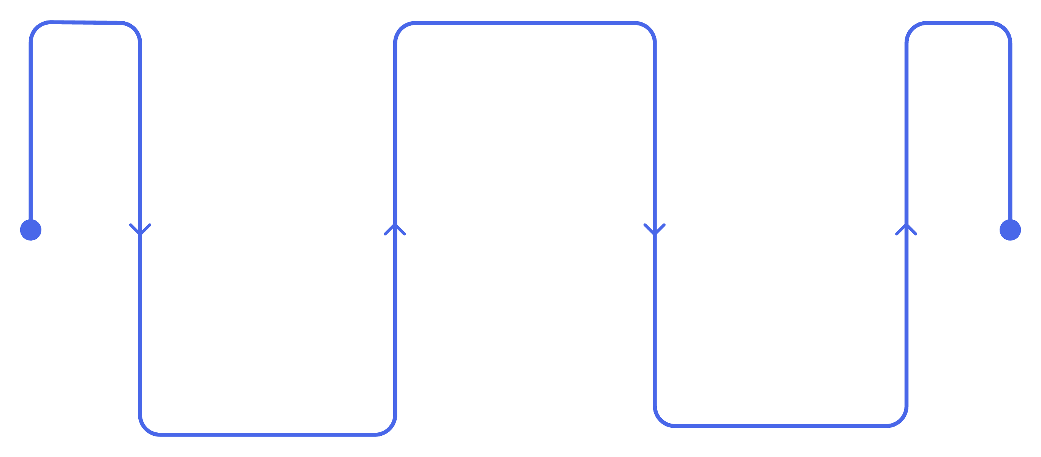
CUSTOMER STORY — GARDINER
What They Heard: Reaching Associates Hardest to Hear
About a year after launching Recognize, Gardiner wanted to know whether associates were using recognition meaningfully — not just frequently.
Anonymous Survey
Gather candid associate feedback
Manager Opportunity
Listening Gap
Coach for meaningful recognition
Identify meaning vs. frequency
The team lacked a consistent formal feedback channel — particularly for field associates. An anonymous survey surfaced manager participation as a clear opportunity for improvement.
Notes:
Speaker: Alexia
Approximately one year after launching Recognize, Gardiner wanted to understand whether associates were using recognition meaningfully.
The team did not have a consistent, formal way to gather feedback, particularly from field associates. An anonymous survey created a structured listening channel.
This is an important example of audience access. Office employees may see an email or platform notification immediately, while field employees may have fewer natural opportunities to participate.
That anonymity is important -- they wanted associates to feel they could express what they really thought.
Once they had a chance to analyze the survey results they did something really smart: They shared the high-level results with all their associates. They even posted the top takeaways on in the Announcements section of their Recognize stream page.

Slide 16



CUSTOMER STORY — GARDINER
What They Did: Turning Insight Into a Manager Challenge
Share with Managers
Survey Insight
Gardiner turned feedback into a visible, manager-led initiative — rather than leaving findings in a report. The result was a +10.7% increase in participation from field associates.
Manager Recognition
Field Participation
Lesson: Listen → Activate managers → Measure the response.
Notes:
Speaker: Alexia
But while posting high-level insights is a good start, it's not enough by itself. Gardiner was committed to acting on it.
They decided to start with a key insight, that while associates appreciate a shout-out from their peers, what would be even more meaningful would be to get more recognition from their direct managers.
Which makes sense.
Gallup has historically found that managers account for approximately 70% of the variation in engagement among teams, which helps explain why manager activation can be such a powerful lever. Gallup
So Gardiner is focusing on engaging managers as the first priority in acting on the survey results.
This is still a work in progress but they're already seeing results: participation from field associates has increased by 10.7% from the previous year.
One specific approach I recommend for engaging managers is to use a Manager's Recognition Challenge. For example, you can set up a challenge for managers to recognize at least 1 of their direct reports per week. You can even set up a series of, say, 4 challenges over 4 weeks to help them form a habit!
Whatever tactic you use, the important lesson is the sequence:
Listen to employees
Identify a practical opportunity
Activate managers
Measure the response

Slide 17
Your Annual Listening Calendar
January
July
December
eNPS
eNPS
Protect recovery time — no new surveys
1
2
3
4
5
April
October
eNPS + Engagement Survey
eNPS + Engagement Survey
Custom pulses are event-driven — launch them when a specific decision demands timely input, not on a fixed schedule.
Golden rule: Report back before you launch again.
Notes:
Speaker: Alexia
This calendar provides structure without turning every month into another survey cycle.
Quarterly eNPS creates a consistent benchmark. April and October engagement surveys provide deeper diagnostics. Custom pulses remain event-driven rather than automatically scheduled.
December can serve as recovery time when possible.
A common mistake is filling the calendar first and then looking for reasons to survey. Start with known business moments and decisions instead.
The golden rule is:
Report back on the previous survey before launching another one. That way, your employees can see that it's not a check-the-box exercise to collect data but rather the first step in finding a data-driven next step for improvement.

Slide 18
Keep Participation Above 70%
Explain why it matters
The Participation Principle
Participation isn't only driven by reminders — it's driven by relevance and follow-through. Employees return to surveys when they trust that their input leads somewhere.
Target the smallest relevant audience
Set an honest completion time
Use reminders selectively
Share themes within seven days
Show what changed before asking again
Notes:
Ideally, you want to get at least 70% participation to ensure you have enough data to provide accuracy. That won't happen on its own, though.
Make sure that you have a communication plan for your survey. People need to know about it, and they need to understand why you're asking them to take the time to respond.
Targeting the smallest relevant audience will help you to get more relevant results because a very large diffuse group will have multiple competing priorities and needs.
It's also important to give people enough time to respond, especially if you have, but not so long that people will put it off indefinitely, thinking "I'll just do it later." You'll also want to think about the best timing and format for reminding people to participate before the survey period is over.
It may not always be possible to share full results within a week, but you may be able to give a preview that quickly and follow up with more details, as well as provide either a plan or at least an assurance that the results will be acted on.
Last but definitely not least, use the insights to make things better. Not only is that the point of the exercise, but it will also encourage people to take the survey when you want to learn how your adjustments landed and determine what's next.

Slide 19
Read Response Quality in Three Layers
Participation
Scores
Comments
Who responded? High participation signals trust and relevance.
What did they experience? Averages reveal sentiment at scale.
Why do they feel that way? Qualitative themes reveal the real story.
High averages with low participation may be less representative than moderate scores with broad participation and consistent themes. Always review all three together.
Notes:
Speaker: Alexia
Participation, scores, and comments answer different questions.
Participation shows who was willing or able to respond. Scores describe the experience of those respondents. Comments provide context about why they answered that way.
A high average with weak participation may be less representative than a moderate score supported by broad participation and consistent themes.
A useful review sequence is:
Check participation
Review the score distribution
Read recurring comment themes
Compare relevant segments
Decide what requires follow-up
Handoff: Alexia to Sam
“We’ve covered how to evaluate participation, scores, and comments together. Sam is now going to show us how to apply that thinking to a heatmap, identify the strongest signal, and decide what to investigate next.”

Slide 20
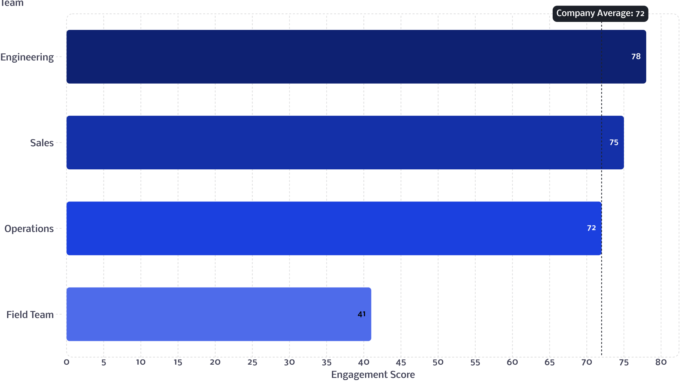
AUDIENCE ACTIVITY
Heatmap Analysis: What Do You See?
Illustrative data — not actual customer results.
Where would you investigate?
What segment would you examine?
What should you avoid concluding?
What pulse might you send?
Notes:
Speaker: Sam
Give participants time to study the illustrative heatmap before offering an interpretation.
Ask:
Where would you investigate first?
Which additional segment would you examine?
What should you avoid concluding?
What focused pulse might you send next?
Encourage participants to separate three levels of interpretation:
What the data shows
What it might suggest
What it cannot establish
The data shows that the Field Team scored lower. It does not show why.

Slide 21
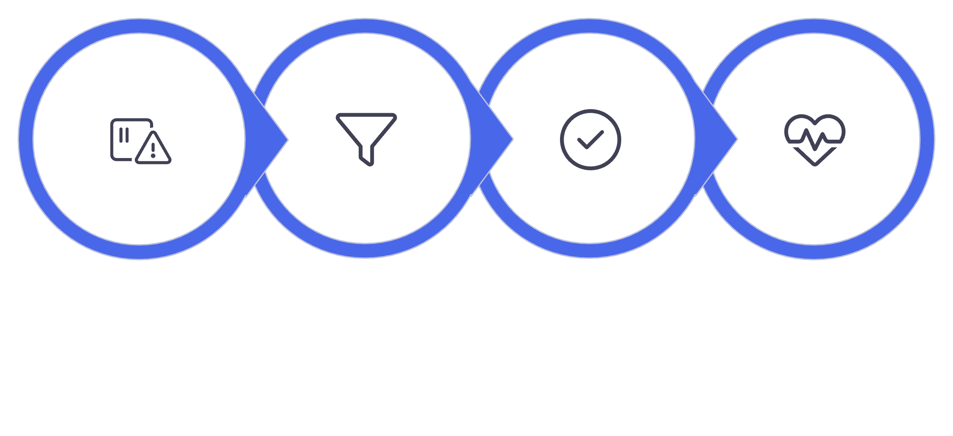
Heatmap Debrief: Signal → Segment → Validate → Pulse
Signal
Segment
Validate
Pulse
Investigate the Field Team — but do not assume the cause. A low score is a signal to explore, not a conclusion to act on. Segment carefully, review comments, then use a focused pulse to test your hypotheses.
Notes:
Speaker: Sam
The Field Team is the appropriate starting point, but the heatmap does not identify the cause.
Segment by location, manager group, tenure, and role. Review participation and comments. Then use a focused pulse to test likely explanations.
Example questions might include:
“What most affects your ability to do your best work?”
“What is one change that would make the greatest difference?”
The goal is to turn the signal into a better question—not jump directly from a score to a solution.

Slide 22
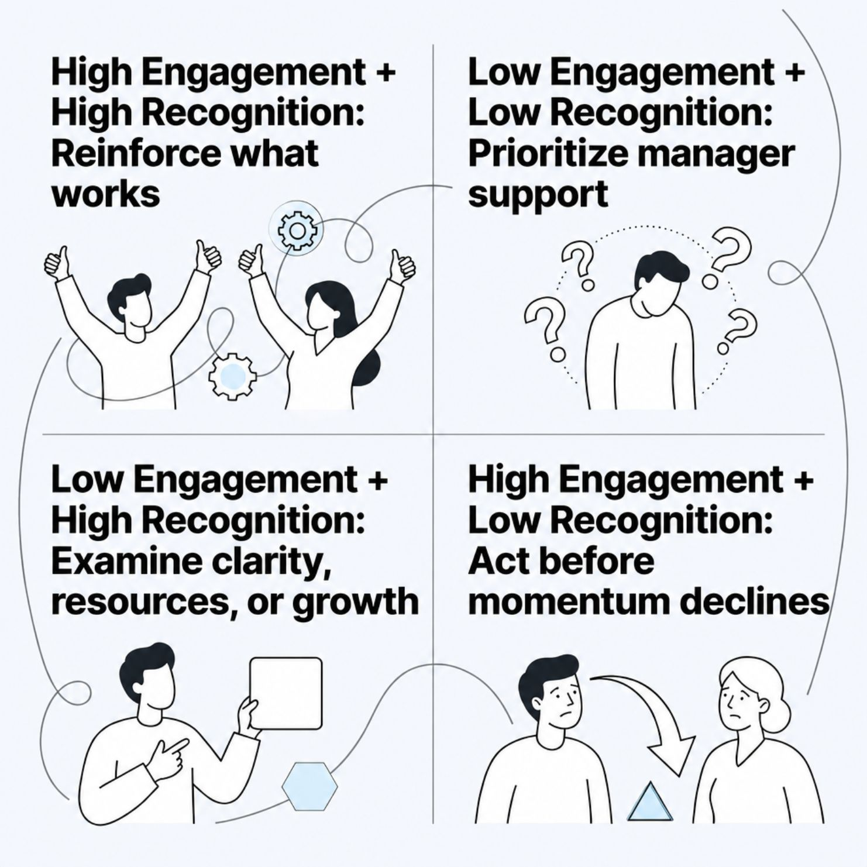
Engagement + Recognition: A Decision Matrix
How to Use This Matrix
Plot your team's scores into one of four quadrants. Each quadrant points to a distinct leadership response — so your next action is clear before you close the report.
Recognition data alone is not enough. Always pair it with engagement context.
Notes:
Speaker: Sam
Looking at engagement and recognition together can help clarify the next step.
When both are high, reinforce what is working.
When both are low, manager support may be the priority.
When recognition is high but engagement is low, examine other conditions such as role clarity, resources, workload, or growth.
When engagement is high but recognition is low, treat it as an early warning. Momentum may be strong today, but employees may not feel that their contributions are sustainably valued.
Handoff: Sam to Brittany
“Once you understand what the data may be telling you, the next question is how to respond credibly. Brittany is going to walk us through the response timeline and then show how these pieces come together inside Recognize.”

Slide 23

The 7-Day Response Loop
Speed signals respect. When employees hear back within a week, they trust the process enough to engage next time.
01
02
03
Acknowledge
Share Initial Themes
Name the Priority and Owner
Thank employees for participating and confirm you've received the results
Communicate what you heard — even before decisions are made
Identify the most important issue and who is responsible for it
04
05
Set Honest Expectations
Commit to a Next Update
Explain what can change quickly and what requires more time
Give employees a date to hear progress — and keep it
Seven days is the response commitment — not the deadline for solving everything.
Notes:
Speaker: Brittany
Seven days is the communication commitment—not the deadline for solving every issue.
For example, an organization cannot redesign compensation within seven days. But it can:
Acknowledge that compensation emerged as a concern
Name the person responsible for reviewing it
Explain the review process
Clarify what information will be considered
Commit to a date for the next update
Within seven days, employees should understand what was heard and what happens next.
Silence creates uncertainty. A credible response protects trust while the longer-term work continues.

Slide 24
From Response to Delivery
Within 7 Days
Within 60–90 Days
Acknowledge feedback and share initial themes
Deliver, measure, or report meaningful progress
Within 30 Days
Decide on the priority action and begin
At each milestone, recognize the managers and employees who moved the action forward. Visible appreciation reinforces the behaviors that drive progress.
Notes:
Speaker: Brittany
Separate the initial response from longer-term delivery.
Within seven days, acknowledge and communicate.
Within 30 days, decide and begin the priority action.
Within 60 to 90 days, deliver, measure, or report meaningful progress.
These are guiding intervals, not universal deadlines. A policy wording change may happen quickly. Compensation, staffing, or system changes may take longer.
Recognition can reinforce progress. If employees request better cross-department communication, recognize the managers who begin holding effective cross-functional check-ins.

Slide 25
AUDIENCE ACTIVITY
Live Platform Demo: Explore the Survey Experience
Ready to launch
Flexible by design
Automated and actionable
Built-in eNPS
Engagement templates
Custom questions, logic, and theming
Audience selection
Smart timing and notifications
Insights and reporting
Notes:
Speaker: Brittany
We’ll now move into Recognize for a guided tour of the survey feature. Rather than building an entire survey, I’ll show the different paths available depending on what you need to learn.
Use one consistent example throughout the demonstration—such as evaluating a recently launched flexible-scheduling policy.
First, show the built-in eNPS experience and engagement survey templates.
Then show custom survey creation, including question options, logic, and theming.
Next, demonstrate audience selection, automatic time periods, and smart notifications.
Finally, show the insights available after responses arrive and connect those insights back to the response-planning process.
The goal is to demonstrate flexibility without suggesting that every survey needs complex configuration.

Slide 26

YOUR TURN
Build Your First Purposeful Pulse
Complete this planning canvas. A pulse without a plan is just a survey.
Decision this pulse will inform
Employees affected
Question 1
Question 2
Response owner
Date themes will be shared
Next progress update
How recognition reinforces the action
Challenge: Launch one purposeful pulse this quarter!
Notes:
Slide 26 — Build Your First Pulse
Speaker: Brittany
Ask participants to think about one real decision from their organization.
Invite them to identify:
The employees affected
Two focused questions
The response owner
The date initial themes will be shared
The date of the next progress update
How recognition might reinforce the response
Remind them that they do not need to solve the entire issue today. They need a focused question and a credible response plan.
If time permits, invite one or two participants to share what they created.

Slide 27
Questions?
What survey decision are you working through right now? Let's talk through it together.
📥 Download
📅 Book Office Hours
🚀 Launch a Pulse
Get the Survey Playbook guide to keep as a reference
Schedule time with your CSM to plan your next survey
Put today's framework into practice with one purposeful pulse this week
Notes:
Speaker: Brittany, with Alexia and Sam contributing
Open with:
“What survey decision are you currently working through?”
Route questions based on subject:
Product configuration, automation, and workflow: Brittany
Gardiner or customer application: Alexia
Survey strategy, heatmaps, and interpretation: Sam
If questions are slow to begin, use one of these prompts:
How frequently are you currently surveying?
Which employee group is hardest for you to reach?
Where does your follow-through process typically slow down?
What survey result are you unsure how to act on?
Closing statement
“The organizations that build trust are not necessarily the ones that survey the most. They are the ones that respond visibly, communicate consistently, and show employees what happened because they spoke up.”

